Slide 1
What If Learning
Faith, Teaching, and Learning
What If Learning: Connecting Christian Faith and Teaching
Notes:
Title slide

Slide 2
Mismatch
Sometimes there is an unintentional mismatch between Christian ethos and teaching and learning.
Teaching and learning can work against a Christian ethos without staff being aware of it.
What If Learning: Connecting Christian Faith and Teaching
Notes:
An example of this mismatch might be a school ethos that (1) emphasizes curiosity and asking the big questions about life and faith, but (2) has teaching and learning practices that restrict this to religious education. We need to raise our awareness of how ethos, content, and pedagogy (teaching and learning) can be unintentionally in conflict.

Slide 3
A Math Example
The school’s ethos may emphasize giving, but all the examples in math may be about getting: shopping, spending, saving.
What If Learning: Connecting Christian Faith and Teaching
Notes:
It would not take a lot to change some math examples to be about giving.
Activity: Ask participants for suggestions of places in math where examples of giving could be used.

Slide 4
A French Example
The school’s ethos may emphasize being unselfish, but all the examples in French may focus on using language for fulfilling personal needs.
Role play may be shopping in French
and making our
needs understood.
What If Learning: Connecting Christian Faith and Teaching
Notes:
It is not a big change to instead role-play welcoming a French speaker who has moved to the area. Introductory French classes might role-play throwing a party for them. Most of the vocabulary stays the same, but the context changes.
Instead of asking students to talk about their own likes and dislikes in Spanish, ask them to talk about the likes and dislikes of a family member, a friend, or another student. Take the focus away from self.
Activity: ask participants to give examples of other changes they can make in language teaching to take the focus away from self and away from a tourist model.

Slide 5
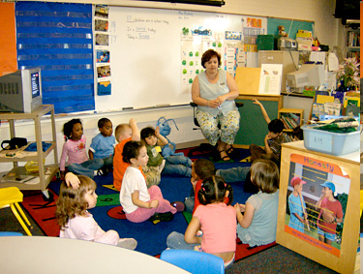
“What If Learning”
What if learning could be different?
What if we could learn to see our teaching in a new way?
What if we could begin with small changes, one moment at a time?
What If Learning: Connecting Christian Faith and Teaching
Notes:
“What If Learning” is about imagining teaching and learning differently. It is asking, What if this lesson were framed by a Christian understanding of life; how would it be different?
The difference is not one major change, but hundreds of small changes that build up to reflect a Christian way of viewing life. For example, it could mean changing coaching methods in PE to intentionally develop restraint and self-control among the players. It could involve looking at different types of riches and poverty in history, not just material riches and poverty. This approach is about lots of small changes across the curriculum, which can make a big difference.
Activity: Give teachers some examples to look at, since it can helpful for teachers to see a range of examples before they learn the approach. Ask them to find an example that they think would work in their school. How is it different from how that lesson might normally be taught? Share results. For more instructions see the activity First Response to Examples (http://www.whatiflearning.com/training/first-response)

Slide 6
The Approach
Seeing anew:
How could a Christian understanding of God, people, and the world provide a different way of seeing a lesson or unit?
Choosing engagement:
How can students engage with this new way of seeing?
Reshaping practice:
What changes to my practice do I need to make as a teacher?
What If Learning: Connecting Christian Faith and Teaching
Notes:
We are going to look at the steps in the approach in this order, but they can be used in any sequence. Why these three steps? These steps help teachers to move change from an idea to classroom practice. We can work through the process using a noneducational example, such as personal fitness.
Step 1. I might imagine the new me, slimmer and fitter.
Step 2. I engage with my new idea, by, say, walking in the evenings.
Step 3. But I have also to change my habits, my practices, in order to support the other two steps. I need to have a decent pair of shoes, clothes that make me visible to drivers, and an MP3 player to listen to music as I walk. Without this final change of habit/practice, the vision of seeing anew is not likely to happen.
Trainers: You may want to work through an example here to see the three steps, such as http://www.whatiflearning.com/examples/4-art-and-hospitality.

Slide 7
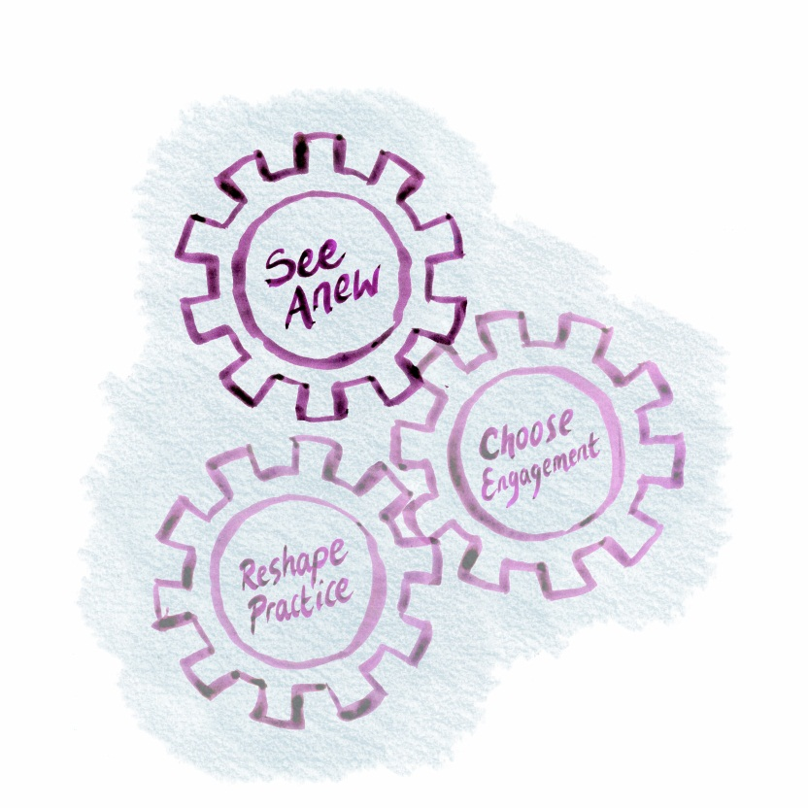
Seeing Anew
Decide on a lesson you would like to teach more Christianly. Think of how you might look at it from a different angle, more in line with Christian belief and ethos.
For ideas, refer to
Strategies for seeing anew
What If Learning: Connecting Christian Faith and Teaching
Notes:
Seeing anew is something the teacher takes responsibility for by deciding the direction of the lesson. The change is not always major; sometimes it means doing the same thing more intentionally or drawing students’ notice to something.
Trainers: Give teachers some examples to illustrate “seeing anew.” See below.
Example 1: You might want to see exploring art in terms of humility rather than “mastery” and move the lesson in that direction. Too often learning is about mastering a subject and knowledge becomes one more thing we consume and collect. It could be different: we could approach a subject with humility and ask what we have to learn and how it might challenge and change us. Seeing Anew 6, 13 (http://www.whatiflearning.com/the-approach/strategies-for-seeing-anew)
Example 2: You might see learning in terms of delighting in God’s world rather than rushing through material or only seeing it in terms of usefulness. Seeing anew 9 (http://www.whatiflearning.com/the-approach/strategies-for-seeing-anew/9-atowards-delighting-in-godaos-world)
Activity: Choose a lesson you teach either individually, in pairs or as a group. Look at the Seeing Anew document and choose the direction in which you would like to move your lesson.
Optional Activity. Choose one or two of the Seeing Anew statements and write what students might be moving from (e.g., from apathy to love). You can print a “from–toward” activity sheet for this.

Slide 8
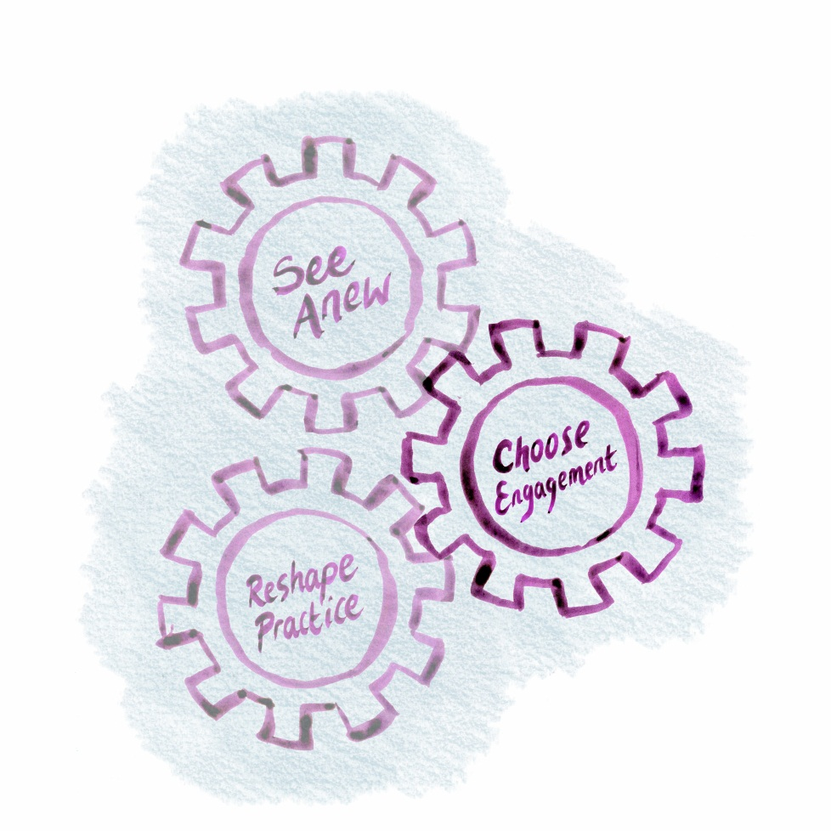
Choosing Engagement
Now think of ways in which learners could engage with this new way of seeing. What opportunities for participation do they have?
If you need some ideas,
refer to
Strategies for choosing
engagement
What If Learning: Connecting Christian Faith and Teaching
Notes:
Choosing engagement is about what the students experience through the activities. Following up our examples:
Example 1: To develop humility when learning about a painting, students might look in detail and use focusing exercises before they state their own opinions. They could end the session by engaging in silent reflection, letting the painting have the last word. Choosing Engagement 1, 9 (http://www.whatiflearning.com/the-approach/strategies-for-engagement)
Example 2: In design classes, students might experience delight by engaging with items made with the purpose of bringing delight. They could then create a design where the primary purpose is to bring delight to others. Choosing Engagement 4 (http://www.whatiflearning.com/the-approach/strategies-for-engagement/4-ato-experience-delight-reflection-and-wonder)
Activity: Look at the Choosing Engagement (http://www.whatiflearning.com/the-approach/strategies-for-engagement) document and choose one strategy that will work with your chosen lesson.

Slide 9
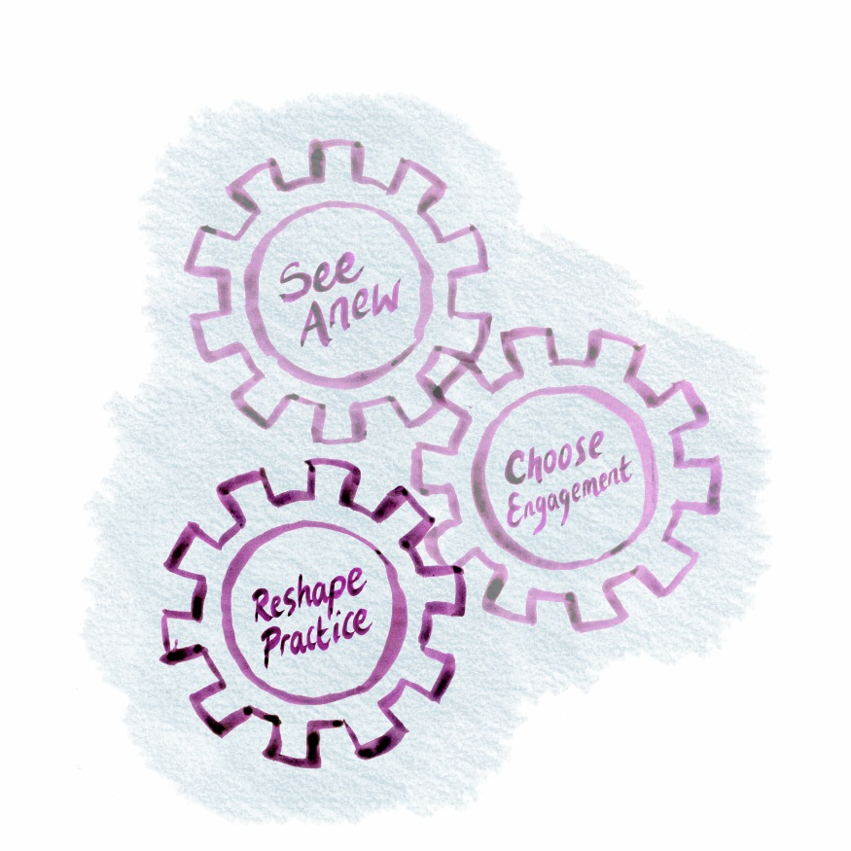
Reshaping Practice
What changes do you, as the teacher, need to make to your practice? Are there habits of the classroom that you need to change in the light of your new emphasis?
For some ideas, refer to
Strategies for reshaping practice
What If Learning: Connecting Christian Faith and Teaching
Notes:
Reshaping practice is about what teachers do. Following up our examples:
Example 1: The teacher might display the painting high, with students seated around it, thereby indicating that the painting is the teacher. The teacher could refer to it in this way and also allow time for focused looking at the beginning and a time of silence at the end. Reshaping Practice 1, 18 (http://www.whatiflearning.com/the-approach/strategies-for-reshaping-practice)
Example 2: Teachers could change the emphasis to one of delight and arrange a display of delightful objects. They could change the task they assign, focusing on delight. Reshaping Practice 10 (http://www.whatiflearning.com/the-approach/strategies-for-reshaping-practice-the-habits-of-the-classroom-1/10-put-skills-in-a-context-of-values)
Activity: Look at the Reshaping Practice (http://www.whatiflearning.com/the-approach/strategies-for-reshaping-practice/full-document) document and choose one strategy that will work with your chosen lesson.
Trainers: From here you may wish to use the handout “How do I do this myself?” Teachers can use these to create their own lessons in a workshop session.

