Slide 1
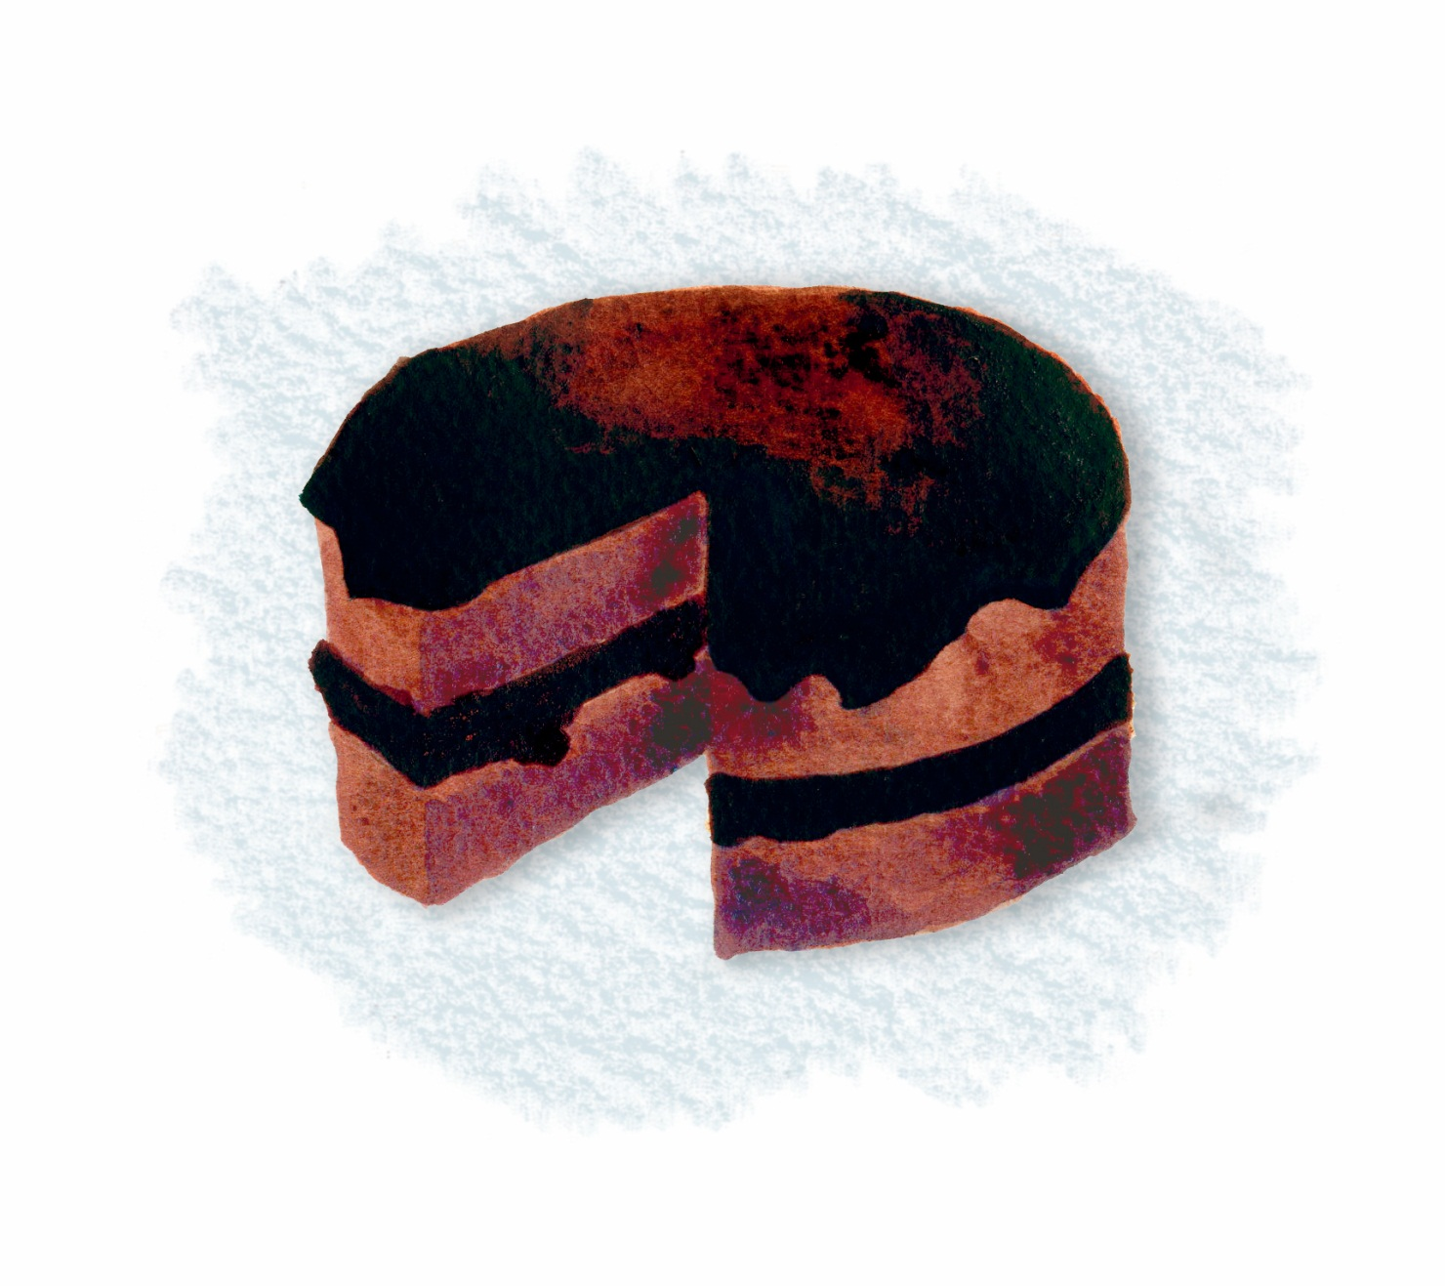
Faith, Schools, and
Chocolate Cake
What If Learning: Connecting Christian Faith and Teaching
Notes:
Title slide

Slide 2
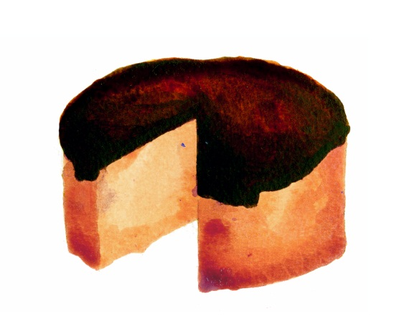
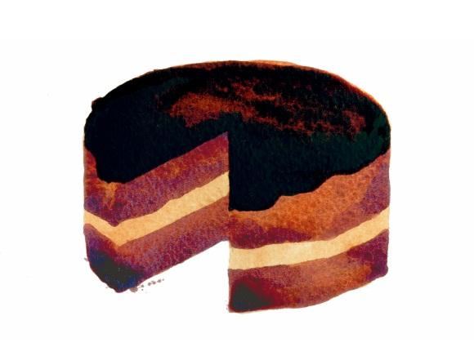
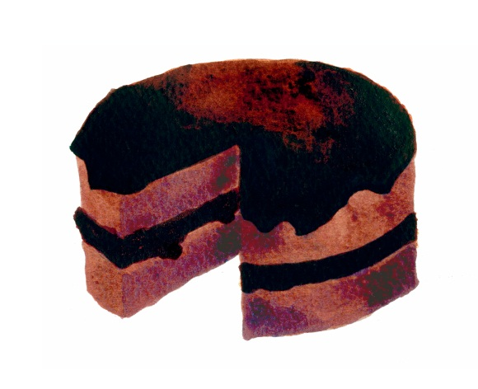
Think Cake!
There is sponge cake with chocolate frosting.
There is chocolate cake with chocolate frosting and vanilla filling.
Then there is triple chocolate cake:
chocolate through and through.
What If Learning: Connecting Christian Faith and Teaching
Notes:
For the trainer: The three aspects of school life are likened to three types of chocolate cake in this presentation. If you can provide the different types of cakes as an, illustration this will make your course even more popular.

Slide 3
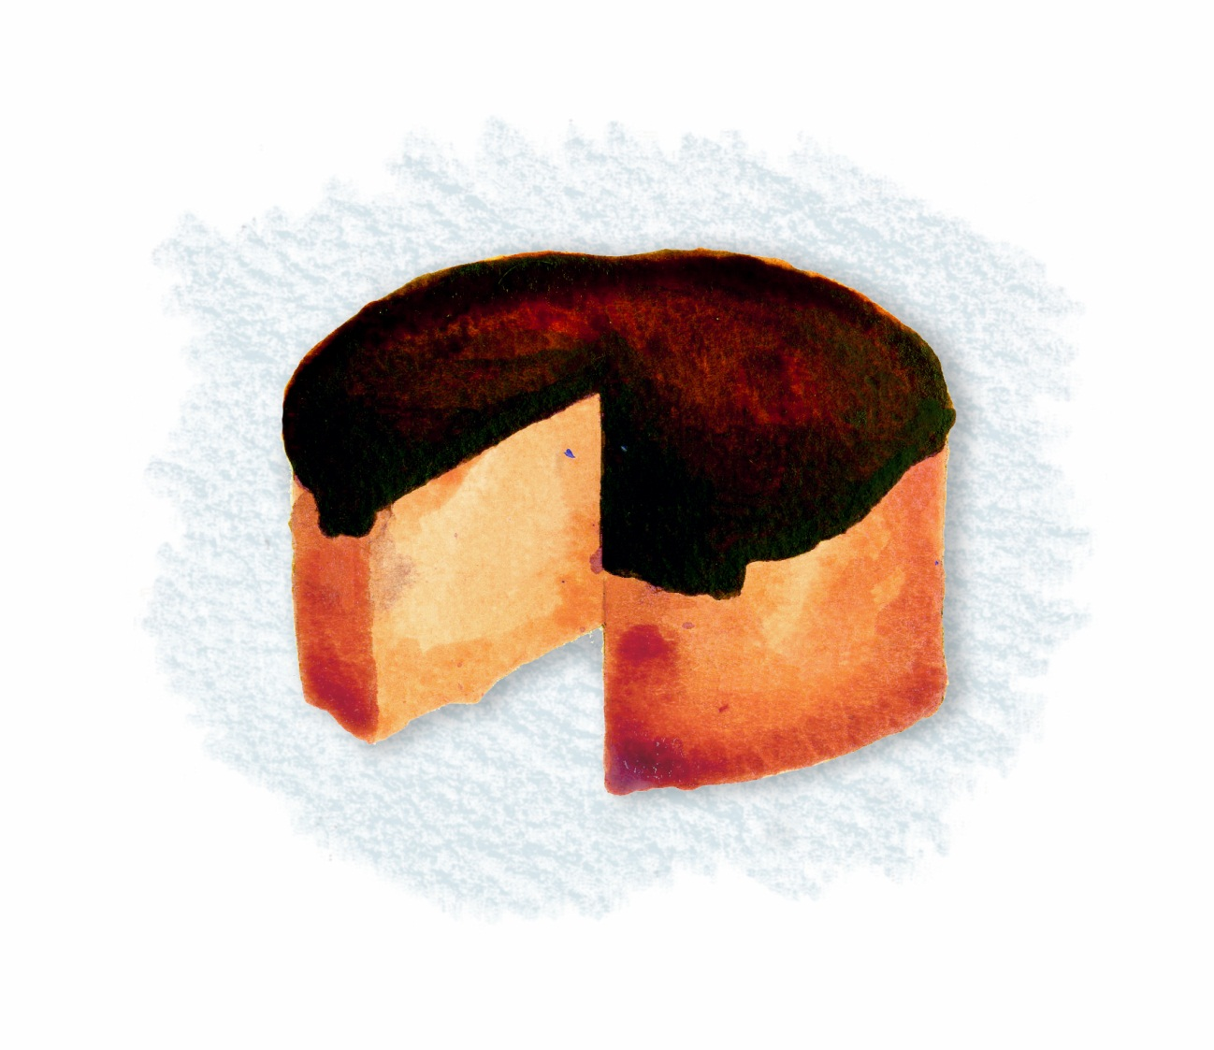
The Frosting on the Cake
Frosting
is nice
Some view a Christian ethos as frosting on the cake.
What If Learning: Connecting Christian Faith and Teaching
Notes:
Let’s be clear about it, chocolate frosting is nice!
Church schools have done pioneering work on ethos and values. Some schools are impressive, having created an almost tangible atmosphere that permeates the whole school and provides a deeply caring context for students and staff. This caring Christian ethos is often what attracts parents and creates a place for students and staff to flourish.
But Christianity should go deeper; it does not have to sit on top of a basically secular curriculum like frosting on a cake. There is nothing wrong with chocolate frosting—frosting is nice—but a cake can be chocolate through and through.

Slide 4
Ethos Is . . .
our school aims, values, and expectations—both explicit and implicit. It is the personality of a school.
What If Learning: Connecting Christian Faith and Teaching
Notes:
Activity: Ask participants to imagine their school as a person. How would someone describe the personality of that person?

Slide 5
Chocolate Cake with
Chocolate Frosting and Vanilla Filling
Even nicer
Christian perspectives begin to influence the content of what we teach, the curriculum, as well as the ethos.
What If Learning: Connecting Christian Faith and Teaching
Notes:
Can a Christian school be like a chocolate cake that has chocolate layers as well as chocolate frosting? Faith affects what we teach, changing the content as well as the ethos. This is usually acknowledged in Bible and religion classes, but it can also be true of other subjects. For example, the translation of the Bible into English or other languages may become part of a world history unit. Christian poetry may feature in English class. A Christian view of ecology might become part of geography. Faith affects the content of the curriculum when staff and students can engage with issues of faith and values in any subject. That is when the chocolate starts to get into the cake.

Slide 6
Curriculum Content Is . . .
what we teach, including where the Christian faith is taught and how it affects what is taught in other subjects.
What If Learning: Connecting Christian Faith and Teaching
Notes:
Activity: ask participants if they have any examples where faith affects the content of subjects other than RE.

Slide 7
Triple Chocolate:
Chocolate Cake, Frosting, and Filling
Beyond words!
Beyond words!
How does faith affect teaching and
learning (pedagogy)?
Can we have triple chocolate?
What If Learning: Connecting Christian Faith and Teaching
Notes:
What about teaching and learning? Does Christianity have anything to say about that? Can we have “triple chocolate cake,” where Christianity influences the ethos, the content of the curriculum, AND the teaching and learning?
The “What If Learning” approach developed on this website looks at how faith affects pedagogy: teaching and learning and how we experience teaching and learning as a whole.
For example, a teacher could use slow and varied methods of reading a text to encourage loving attention as an expression of respect (http://www.whatiflearning.com/examples/98-loving-texts).
Storytelling could be used in math when learning about pie charts, showing how math can be used to bring about change. The teacher could tell the story of how Florence Nightingale used pie charts to give her facts and figures impact and bring about the reform of hospitals (http://www.whatiflearning.com/examples/62-pie-charts-and-truth). Math skills can be demonstrated and practiced using significant information: for example students can learn percentages using bananas or coffee, exploring what percentage goes to the grower (http://www.whatiflearning.com/examples/33-math-and-justice).

Slide 8
Pedagogy is...
how we teach and learn;
classroom practice;
the habits of the classroom;
the experience of teaching and learning as a whole.
What If Learning: Connecting Christian Faith and Teaching
Notes:
Pedagogy is not often connected to faith, but it needs to be considered if we want Christian faith and values to be integrated across our schools. It deals not only with how we teach but also with teaching and learning as a whole—how all the parts fit together, for the whole is greater than the sum of the parts. If we are not careful, our approach to teaching and learning can create lessons that send messages we don’t intend.

Slide 9
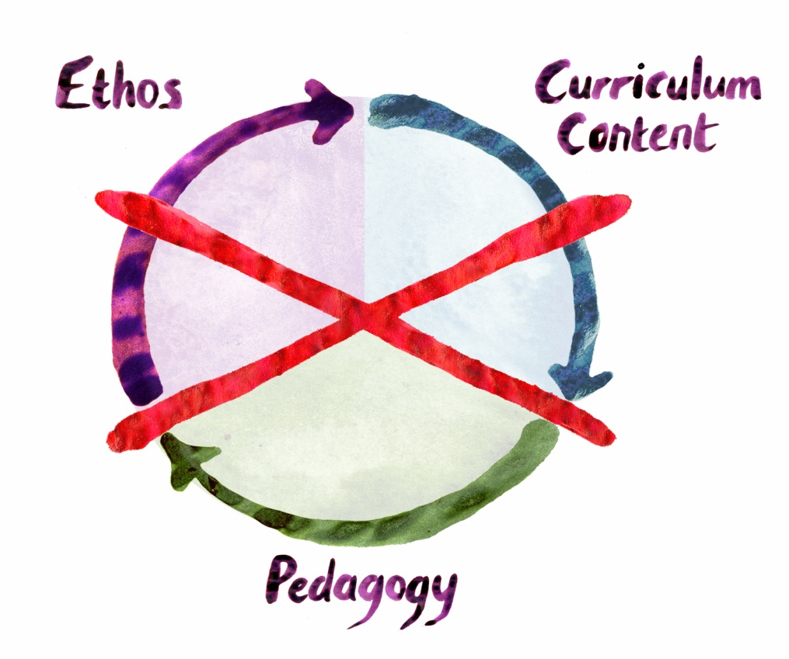
Three aspects
that work together.
There are no walls
between them.
Not three separate
areas of a school.
What If Learning: Connecting Christian Faith and Teaching
Notes:
Ethos, curriculum, and pedagogy work together and interact. There are no walls between them, which is why some of our examples overlap with ethos and content.

Slide 10
How Does Pedagogy Work with
Ethos and Curriculum Content?
An analogy of the way in which the three aspects of a school work together might be a meal.
What If Learning: Connecting Christian Faith and Teaching
Notes:
When we plan a meal, we take care about how food is presented as well as creating a welcoming atmosphere and cooking good food.

Slide 11
When we invite someone to a meal, we pay attention to the content of the meal.
(Curriculum content)
The meal takes place in a context of hospitality and friendship.
(Ethos)
Both of these can be undermined by paying no attention to how the meal is presented
and experienced as a whole.
(Pedagogy)
What If Learning: Connecting Christian Faith and Teaching
Notes:
We can understand this analogy in terms of the three aspects of school life: the food equates to curriculum content, hospitality relates to ethos, and how a meal is presented and experienced relates to pedagogy (teaching and learning). We do not take the time and effort to cook a wonderful meal and make people feel welcome, and then neglect how we present the food. We would lay down an attractive tablecloth, light candles, and fold the napkins.
In this approach, we will be looking at the third aspect, the way teaching and learning is experienced.

Slide 12
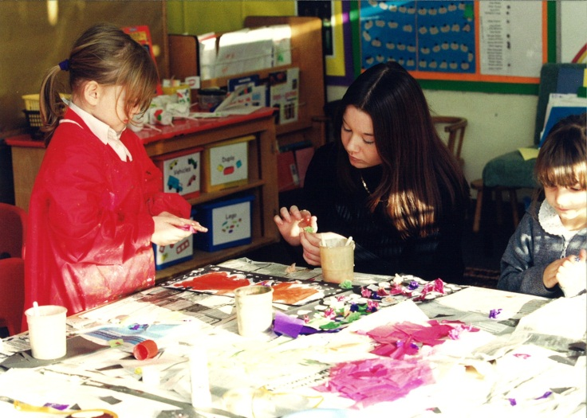
Pedagogy involves paying attention to how the curriculum content is experienced through teaching and learning so that it complements the ethos and does not undermine it.
Pedagogy is what allows the content to fly.
What If Learning: Connecting Christian Faith and Teaching
Notes:
Teaching and learning is not about delivering the content of Christianity; it is about providing a Christian framework for learning, the thinking and values context in which teaching and learning takes place.
Trainers: you may wish to use the analogy of a Jell-O mold. When you see the dessert, you do not see the mold, but the mold has profoundly shaped the gelatin. In a similar way, the pedagogy developed on this site is not always “visibly” Christian, but it is profoundly shaped by the Christian faith. Be careful to point out that Christian faith does not rigidly shape pedagogy; like a gelatin mold ,the process is much more fluid and creative.

